Slide 1
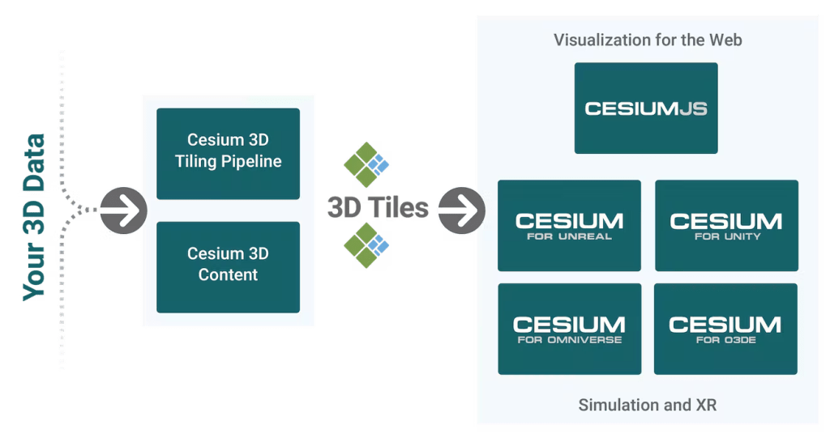



1. System Architecture
GeoJSON
GLB
Terrain
Web Server
2D Base Map
Object
GeoJSON : 3D Buildings / Road Polygons / Walls
GLB: 3D Models

